Slide 1


Analyzing Customer Feedback for Improving Airline Quality using Machine Learning
2nd April 2025
Nicholas Oen

Slide 2
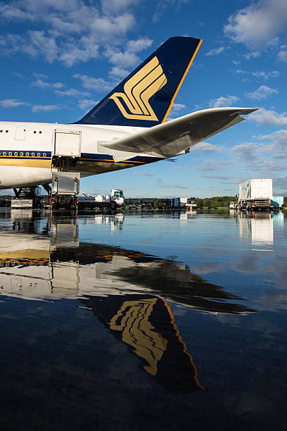
Agenda
1 . Problem Statement
2 . Stakeholders and Value proposition
3 . Customer Feedback Analysis
4 . Discovering Insights
5 . Proposing Solutions

Slide 3
1 .
2.
Stakeholders
1 . Upper Management
2 . In-Flight Service Crew
3 . Ground Team Staff
4 . Additional Vendors
3.
4.
Overall decision makers of the company that can execute strategies.
Airline stewards & stewardesses. In - flight staff.
Airport staff, customer service and check in counter personnel
Back end staff, F&B, maintenance and other product providers.

Slide 4
Setting the context
In 2023, the global airline industry was estimated to be worth 762 billion USD.
It is projected to only grow further and further in the future.
There are about 800 commercial airlines operating passenger flights.
To stay at the top of the food chain in the commercial airline industry.

Slide 5
Value Propositions
Business prospects
Better service and experience will no doubt lead to increase in customers
Long-term value
Maintaining standards will allow us to stay at the top consistently.
Pipeline Efficiency
Improving existing procedures and strategies to improve service quality.
Notes:
Bolding important texts

Slide 6

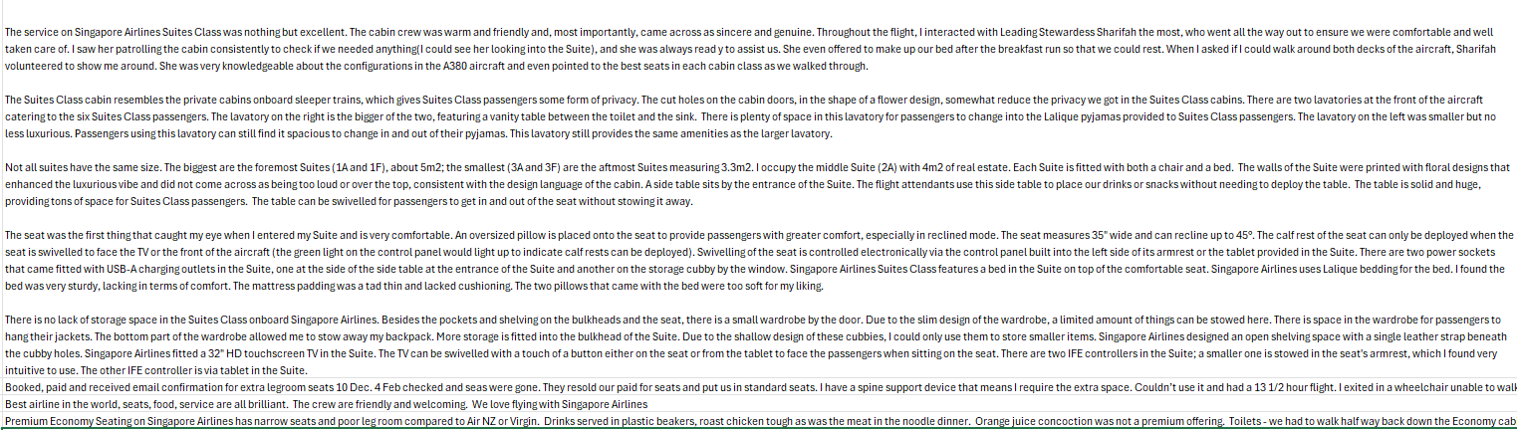
What are we working with?
Customer service surveys and reviews were collected into a database for us to analyze.

Slide 7
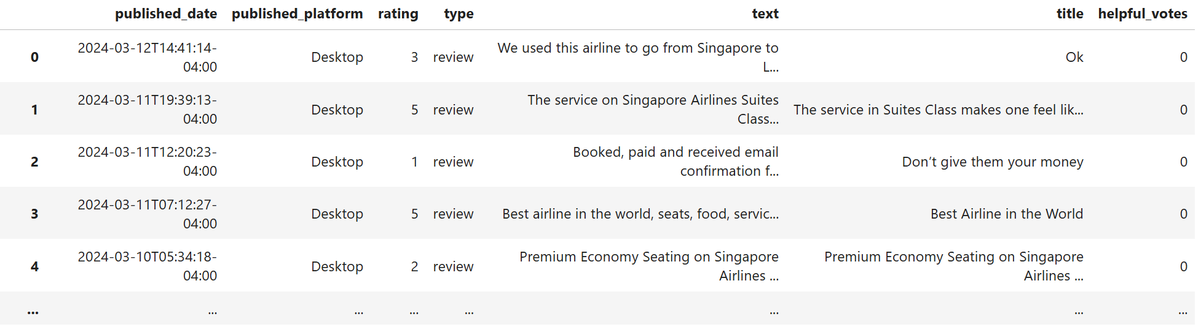
What are we working with?
The data is compiled into the jupyter notebook as a dataframe.

Slide 8

Process layout
Data Processing and Cleaning
From the data we have collected from various surveys and feedback forms, we can analyze and identify the general sentiments of our customers.
Sentiment Analysis of feedback using Supervised Learning
Topic Modelling through unsupervised learning
Insights and recommendations

Slide 9
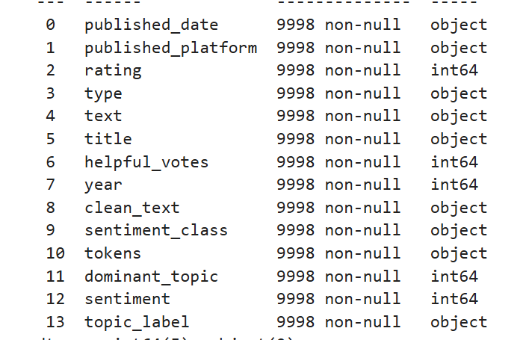
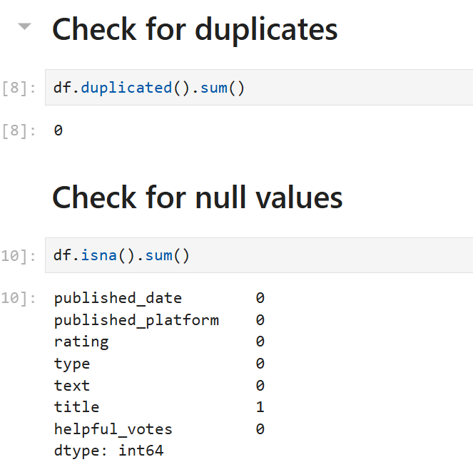
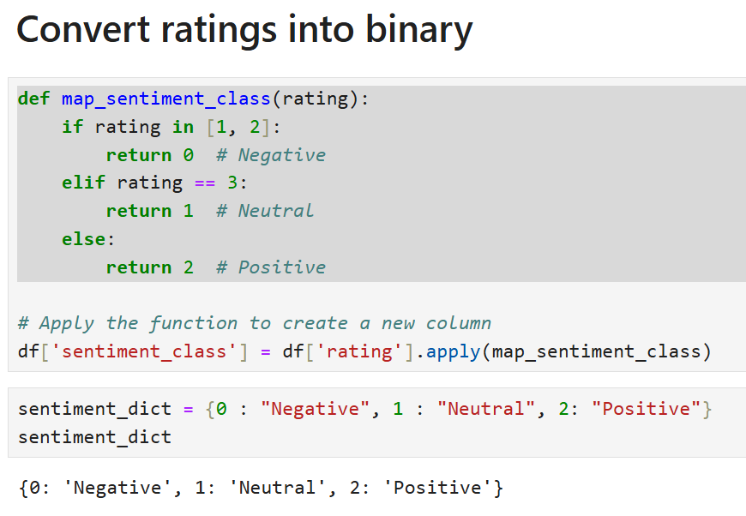
Data Cleaning & Processing
Standardizing Data types
Removing duplicates and null values
Reviews and ratings
Converting our dataset columns into readable digital formats for our text and sentiment analysis.
Remove useless rows and duplicates to improve model performance further down.
To analyze the data, we need to break down the ratings into different binary classes.

Slide 10
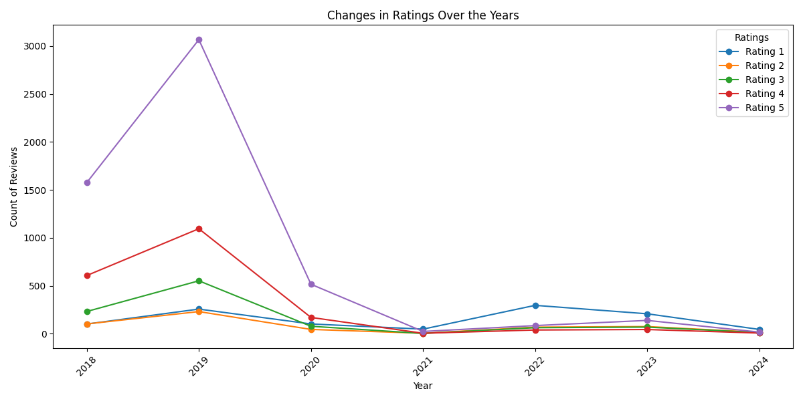
Exploratory Data Analysis - Ratings
Sharp decline in 2020 was due to the COVID-19 pandemic.
Rating value of 5 had the highest count till post 2021.

Slide 11
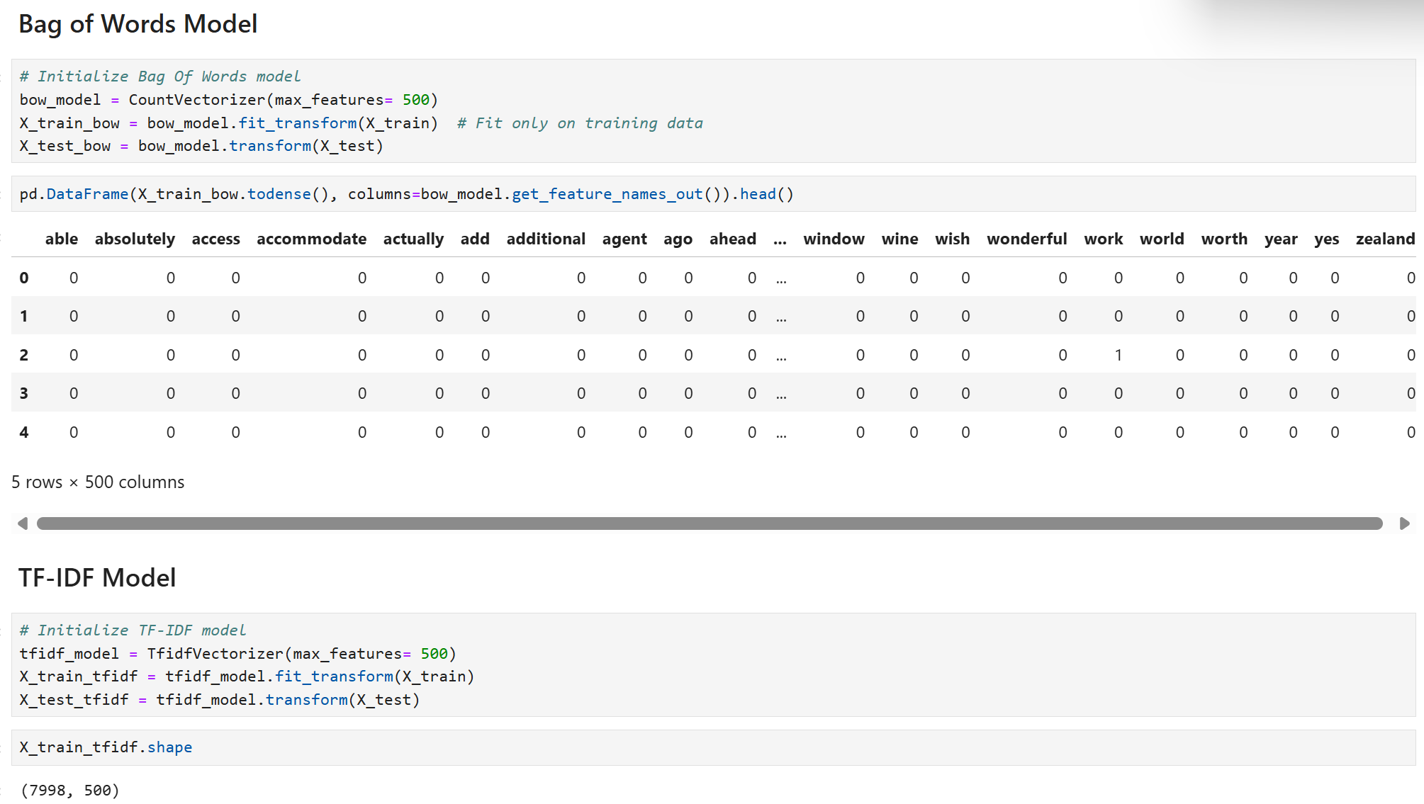
Sentiment Analysis - Vectorizers
Use 2 different vectorizers,
Bag of Words and TF-IDF model.
Converting text data into numerical format so we can run it through our classifiers.

Slide 12
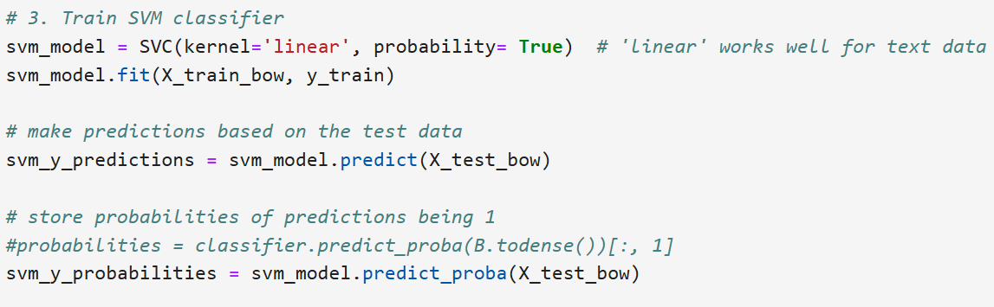
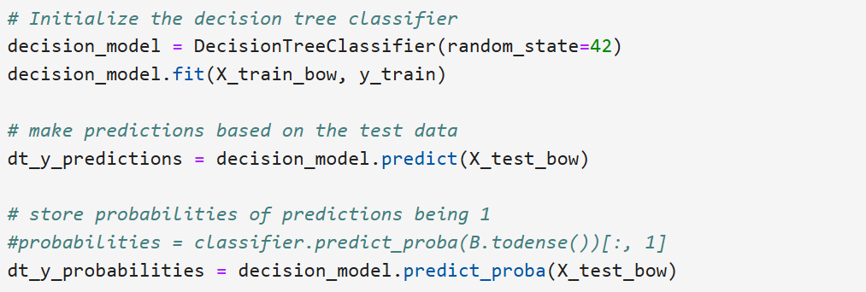
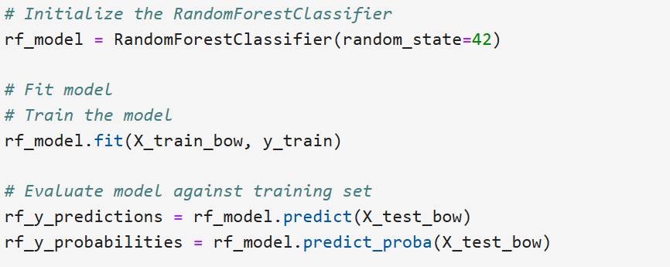
Sentiment Analysis - Classifiers
We now run the text data that has been vectorized through different classifiers to predict their sentiments.
Support Vector Machines
Decision Tree Model
Random Forest Model

Slide 13
Sentiment Analysis - Classifiers
Sentiment Analysis - Results
Best results out of the 3 classifiers among the 2 vectorized features.
Random Forest may not have the best Accuracy Score, but has the best ROC_AUC score.
Agricultural Farm Company

Slide 14
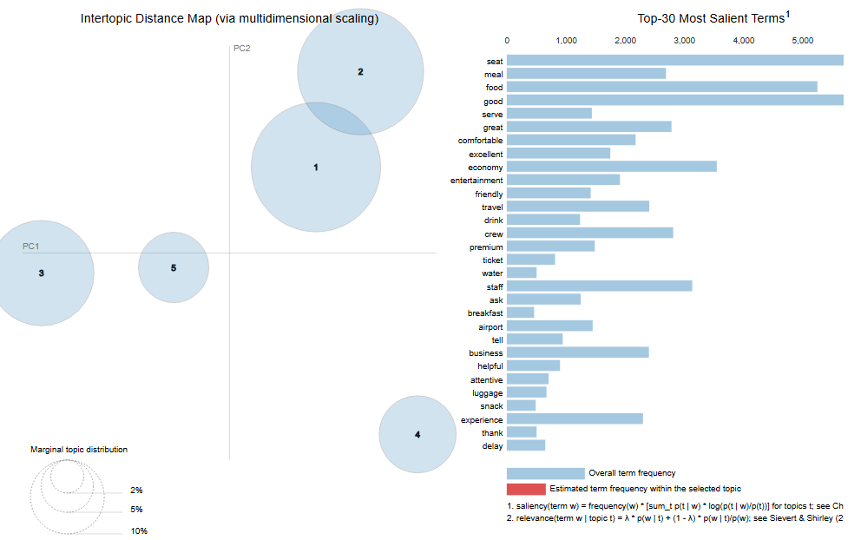
Unsupervised Learning - Topic Modelling
For our text data, we can run Topic Modelling to bundle together similar words to try and gather insights of our feedback.
Removing “stopwords” and redundant ones for better performance

Slide 15
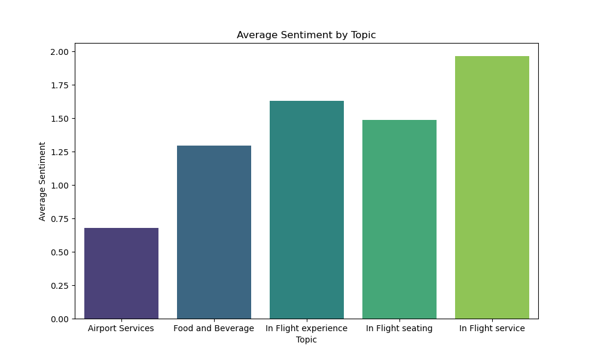
Unsupervised Learning - Topic Modelling
Airport Services received the most negative feedback from our customers.
In flight service was highly praised.

Slide 16
Recommendations
On the ground
Improve our airport staff procedures with customers using the feedback given
In the air
In flight experiences that have not been hitting the mark can be improved from feedback
For the future
Overall key decisions can be made by upper management to make changes for the better
Notes:
Bolding important texts

Slide 17

Questions?

